Slide 1
DEEP LEARNING COURSE
FALL 2024
Usman Khan, PhD

Slide 2
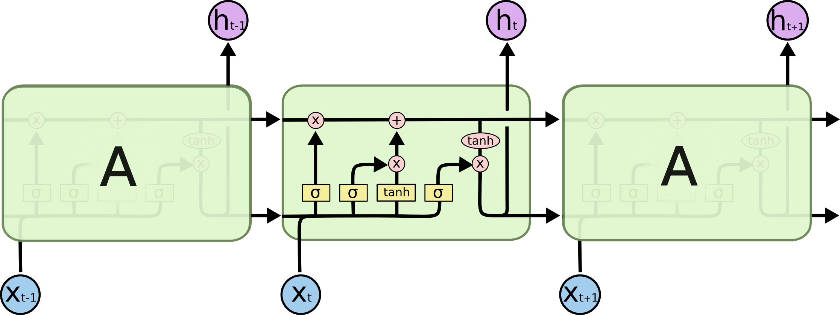
LSTM NETWORK

Slide 3
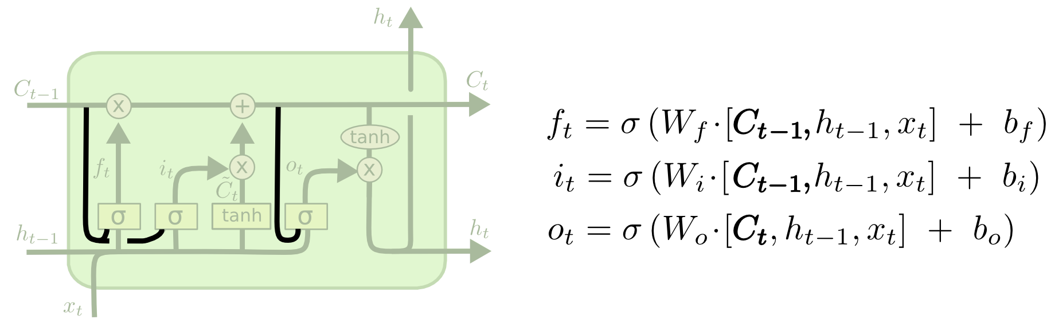
PEEP HOLE LSTM
It adds “peepholes” to the input, forget, and output gates, so they can see the previous cell state ct-1
Decisions will be made taking into account the long term memory

Slide 4
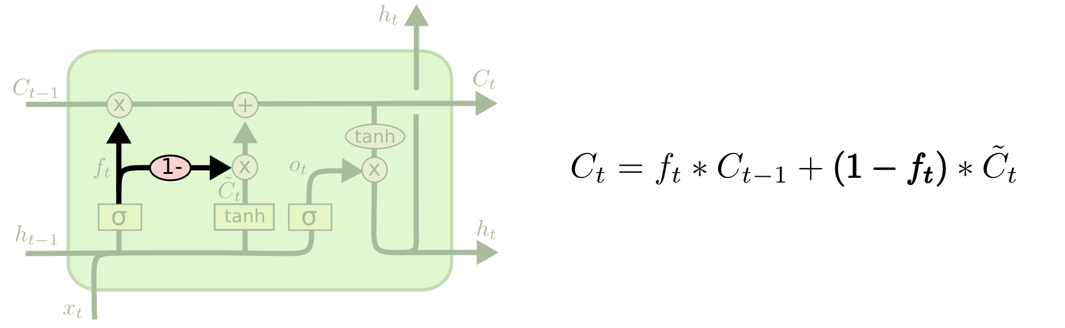
COUPLED FORGET & INPUT GATE LSTM
Instead of having a separate decision what to store in the long term memory based on input and short term memory only
Now we have an input from the long term memory as well

Slide 5
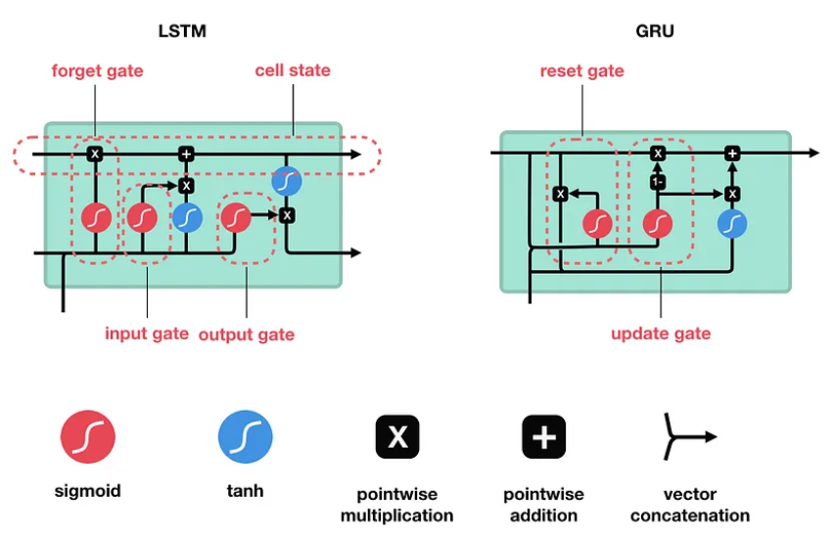
GATED RECURRENT UNIT (GRU)

Slide 6
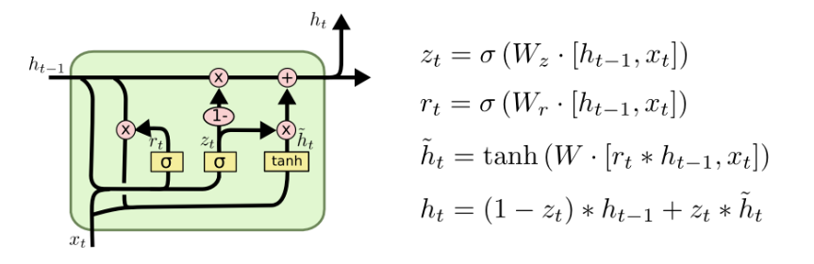
GATED RECURRENT UNIT (GRU)
A slightly more dramatic variation on the LSTM is the Gated Recurrent Unit, or GRU, introduced by Cho, et al. (2014).
It combines the forget and input gates into a single “update gate.” The resulting model is simpler than standard LSTM models, and has been growing increasingly popular.

Slide 7
GATED RECURRENT UNIT (GRU)
The GRU is a variant of the LSTM
It retains the LSTM’s resistance to the vanishing gradient problem, but its internal structure is simpler
Faster to train, since fewer computations are needed to make updates to its hidden state
Instead of the input (i), forgot (f), and output (o) gates in the LSTM cell, the GRU cell has two gates,
An update gate z and a reset gate r
The update gate defines how much previous memory to keep around
The reset gate defines how to combine the new input with the previous memory
There is no persistent cell state distinct from the hidden state as it is in LSTM

Slide 8
COMPARISON OF GRUS & LSTMS
Ser | LSTMs | GRUs
a. | LSTM has a more complex architecture compared to GRU. It consists of three gates: the input gate (i), forget gate (f), and output gate (o). These gates control the flow of information through the cell state, allowing the LSTM to remember or forget information over time. | GRU has a simplified architecture with two gates: the update gate (z) and reset gate (r). The update gate controls how much of the previous hidden state should be retained, and the reset gate determines how much of the past information to forget.
b. | LSTM typically has more parameters than GRU due to the additional gate (forget gate). This can make LSTM more powerful but also more prone to overfitting, especially on smaller datasets. | GRU has fewer parameters since it lacks the forget gate. This can make it more computationally efficient and less prone to overfitting, making it a good choice for smaller datasets.
c. | Due to its more complex architecture, LSTM can potentially learn more complex patterns and relationships in the data. It is well-suited for tasks where capturing long-term dependencies is critical. | While simpler, GRU can still learn to capture long-term dependencies effectively. It performs well in many natural language processing tasks and is a popular choice for various sequence modeling tasks.
d. | LSTM has more parameters, which can result in slightly slower training times compared to GRU, especially on larger datasets. | With fewer parameters, GRU may have faster training times, making it more efficient for larger datasets.

Slide 9
WORD EMBEDDINGS
Wikipedia defines word embedding as the collective name for a set of language modeling and feature learning techniques in natural language processing (NLP) where words or phrases from a vocabulary are mapped to vectors of real numbers
Deep learning models, like other machine learning models, typically don’t work directly with text; the text needs to be converted to numbers instead
The process of converting text to numbers is a process called vectorization
An early technique for vectorizing words was one-hot encoding
Since the similarity between any two words (measured by the dot product of the two word vectors) is always zero
The NLP community has borrowed techniques from Information Retrieval (IR) to vectorize text using the document as the context
Techniques from Information Retrieval (IR) to vectorize text using the document as the context. Notable techniques are Term Frequency-Inverse Document Frequency (TF-IDF) , Latent Semantic Analysis (LSA) , and topic modeling

Slide 10
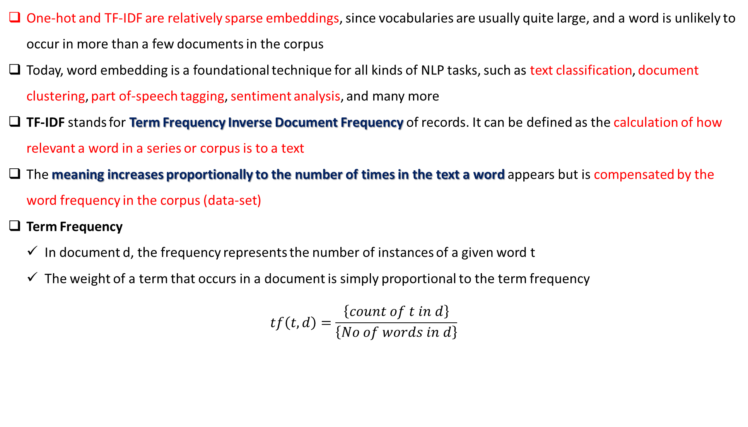
WORD EMBEDDINGS
One-hot and TF-IDF are relatively sparse embeddings, since vocabularies are usually quite large, and a word is unlikely to occur in more than a few documents in the corpus
Today, word embedding is a foundational technique for all kinds of NLP tasks, such as text classification, document clustering, part of-speech tagging, sentiment analysis, and many more
TF-IDF stands for Term Frequency Inverse Document Frequency of records. It can be defined as the calculation of how relevant a word in a series or corpus is to a text
The meaning increases proportionally to the number of times in the text a word appears but is compensated by the word frequency in the corpus (data-set)
Term Frequency
In document d, the frequency represents the number of instances of a given word t
The weight of a term that occurs in a document is simply proportional to the term frequency
$$tf\left(t,d\right)=\frac{\left\{count of t in d\right\}}{\left\{No of words in d\right\}}$$

Slide 11
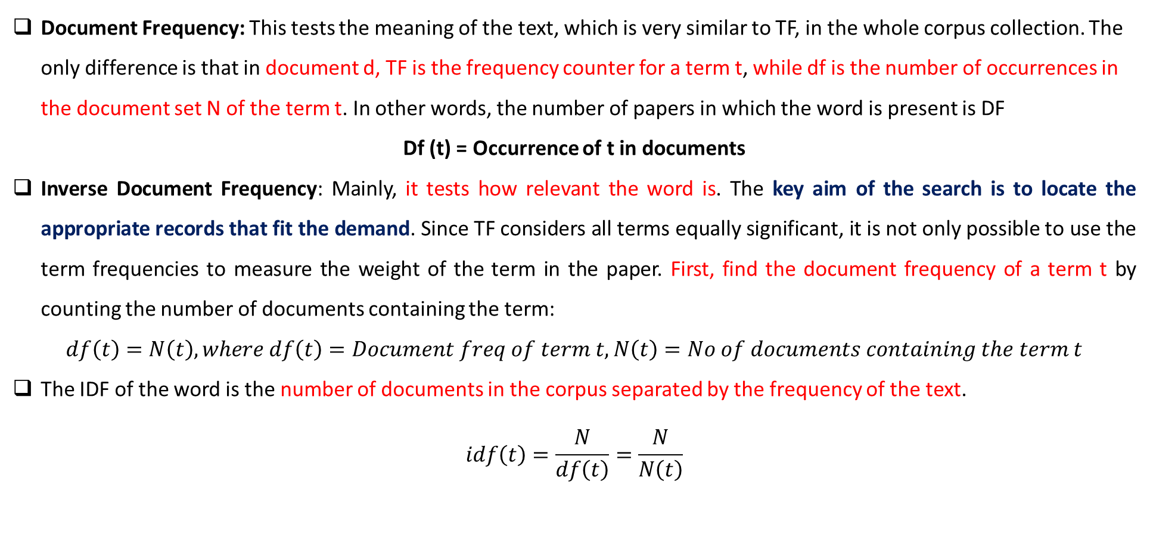
WORD EMBEDDINGS
Document Frequency: This tests the meaning of the text, which is very similar to TF, in the whole corpus collection. The only difference is that in document d, TF is the frequency counter for a term t, while df is the number of occurrences in the document set N of the term t. In other words, the number of papers in which the word is present is DF
Df (t) = Occurrence of t in documents
Inverse Document Frequency: Mainly, it tests how relevant the word is. The key aim of the search is to locate the appropriate records that fit the demand. Since TF considers all terms equally significant, it is not only possible to use the term frequencies to measure the weight of the term in the paper. First, find the document frequency of a term t by counting the number of documents containing the term:
$$df\left(t\right)=N\left(t\right), where df\left(t\right)=Document freq of term t, N\left(t\right)=No of documents containing the term t$$
The IDF of the word is the number of documents in the corpus separated by the frequency of the text.
$$idf\left(t\right)=\frac{N}{df\left(t\right)}=\frac{N}{N\left(t\right)}$$

Slide 12
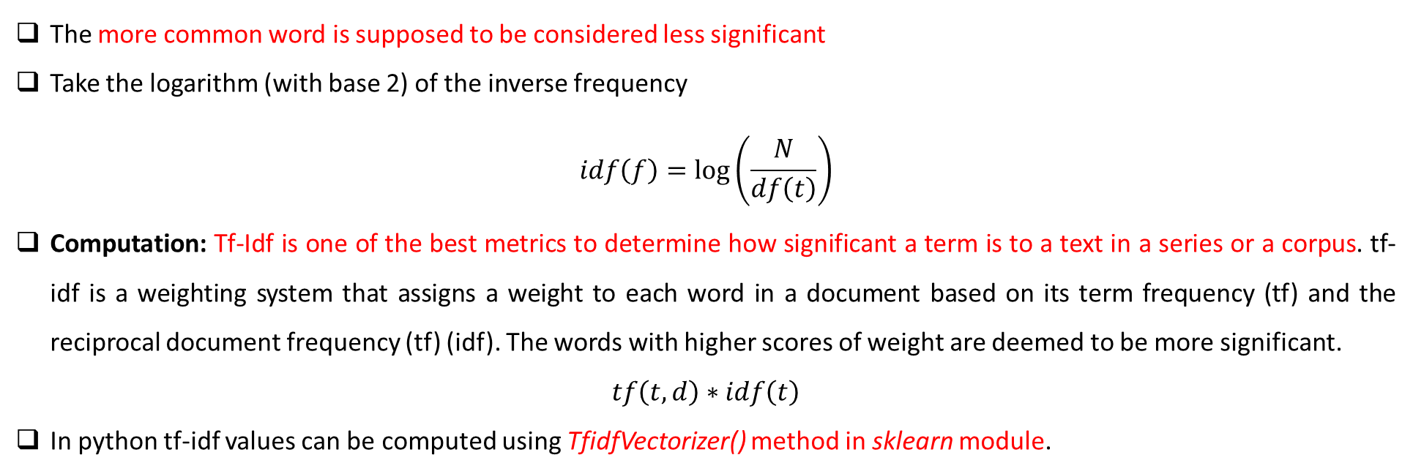
WORD EMBEDDINGS
The more common word is supposed to be considered less significant
Take the logarithm (with base 2) of the inverse frequency
$$idf\left(f\right)=\log\left(\frac{N}{df\left(t\right)}\right)$$
Computation: Tf-Idf is one of the best metrics to determine how significant a term is to a text in a series or a corpus. tf-idf is a weighting system that assigns a weight to each word in a document based on its term frequency (tf) and the reciprocal document frequency (tf) (idf). The words with higher scores of weight are deemed to be more significant.
$$tf\left(t,d\right)∗idf\left(t\right)$$
In python tf-idf values can be computed using TfidfVectorizer() method in sklearn module.

Slide 13
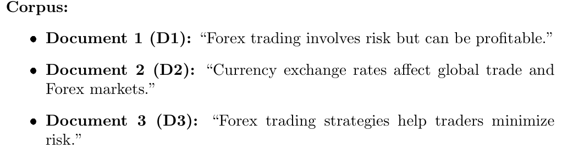
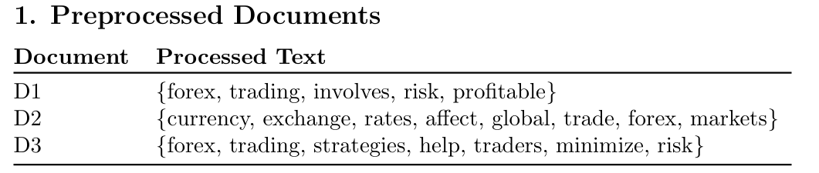
TF IDF EXAMPLE
After Processing that includes
Tokenization
Stop words removal
Lower case

Slide 14
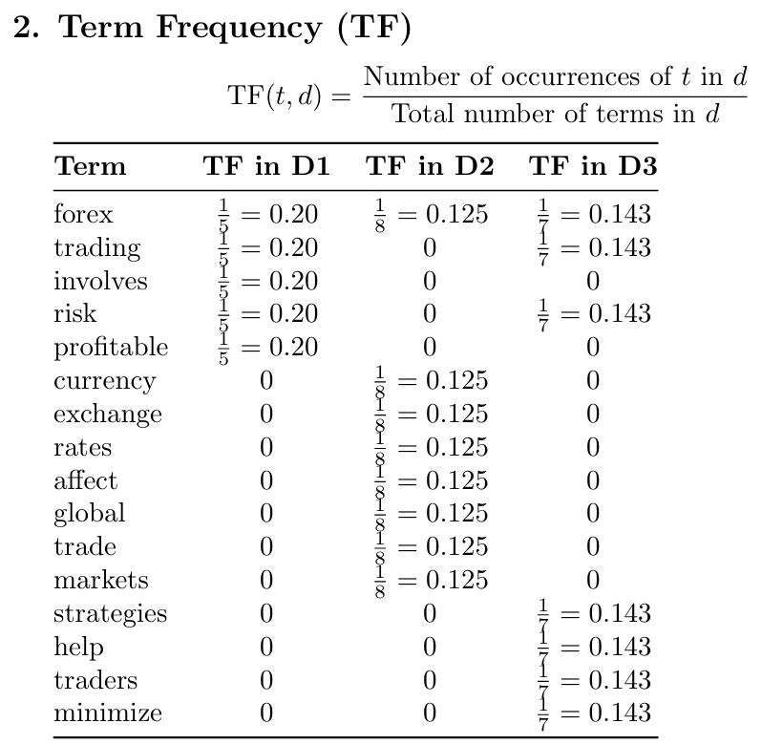

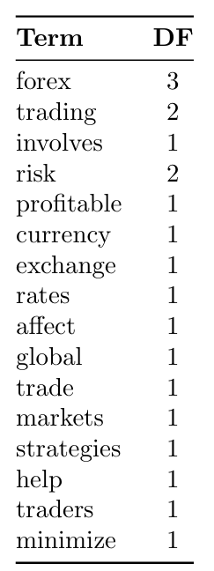
TF IDF EXAMPLE

Slide 15
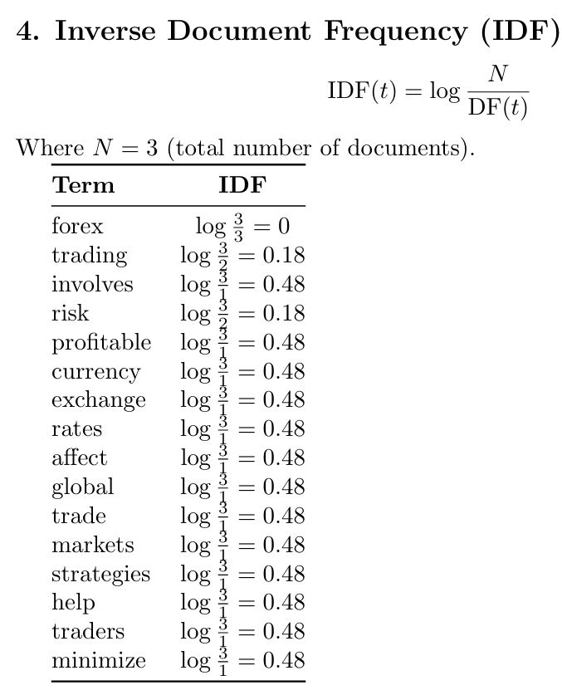
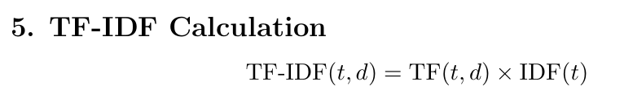
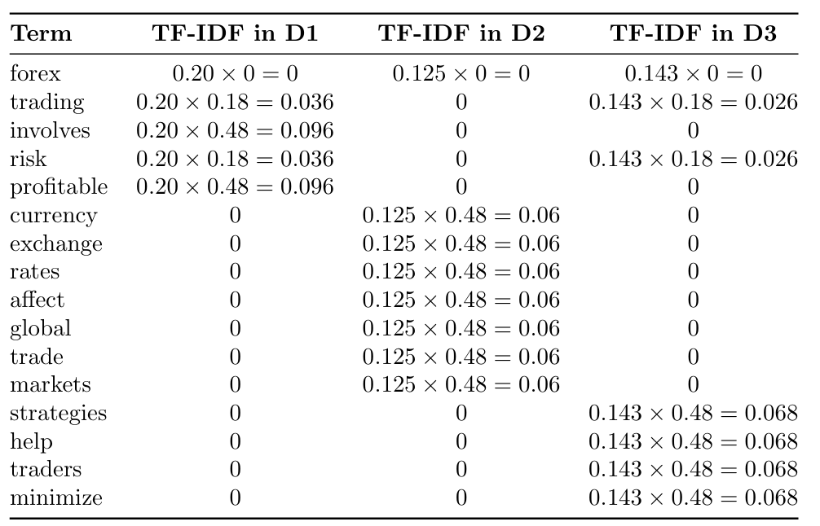
TF IDF EXAMPLE

Slide 16
LATENT SEMANTIC ANALYSIS
LSA deals with the following kind of issue:
Example: mobile, phone, cell phone, telephone are all similar but if we pose a query like “The cell phone has been ringing” then the documents which have “cell phone” are only retrieved whereas the documents containing the mobile, phone, telephone are not retrieved.
Assumptions of LSA:
The words which are used in the same context are analogous to each other.
The hidden semantic structure of the data is unclear due to the ambiguity of the words chosen.
Singular Value Decomposition:
Singular Value Decomposition is the statistical method that is used to find the latent(hidden) semantic structure of words spread across the document
Let’s recap SVD

Slide 17
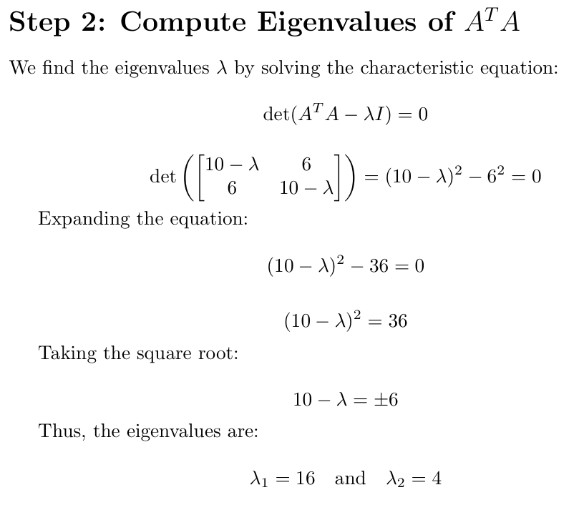
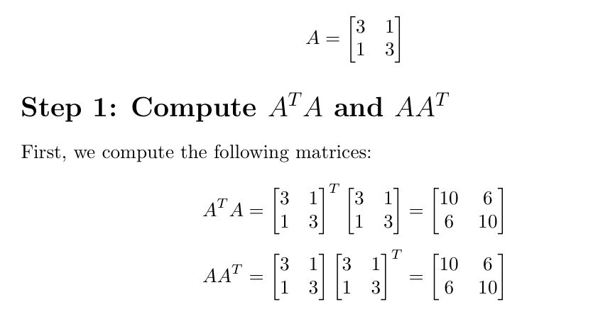
Singular Value Decomposition SVD RECAP

Slide 18
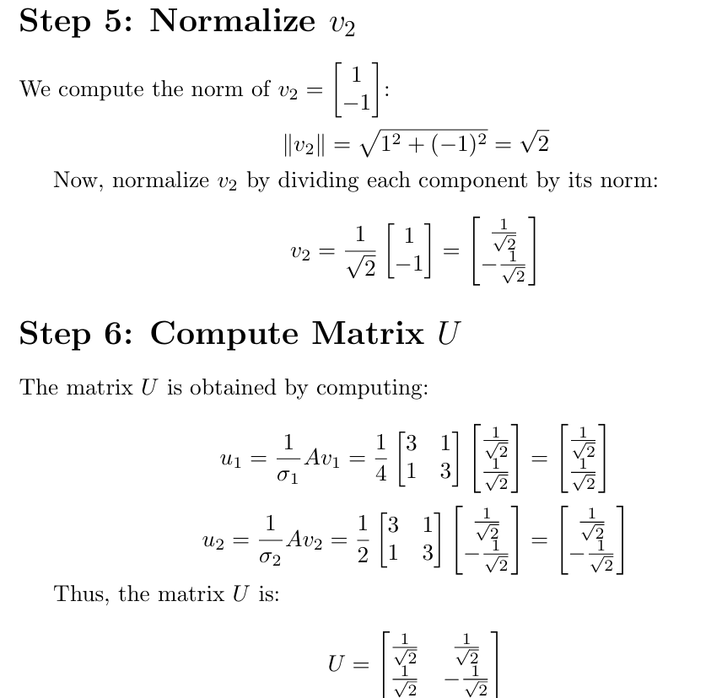
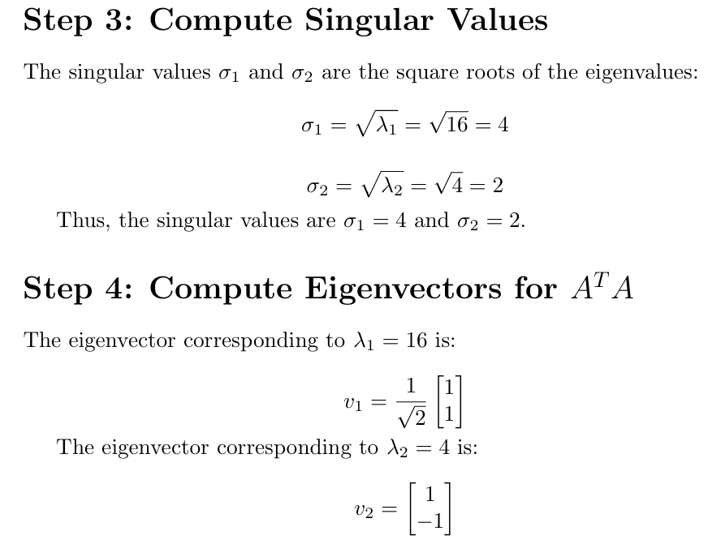
SVD RECAP

Slide 19
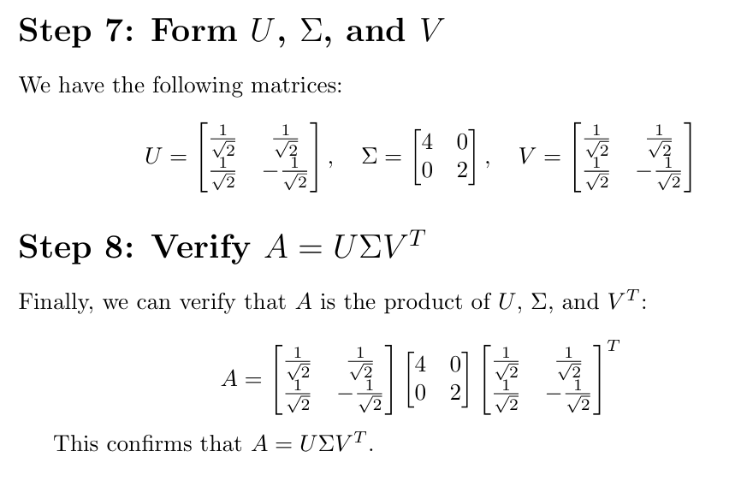
SVD RECAP

Slide 20
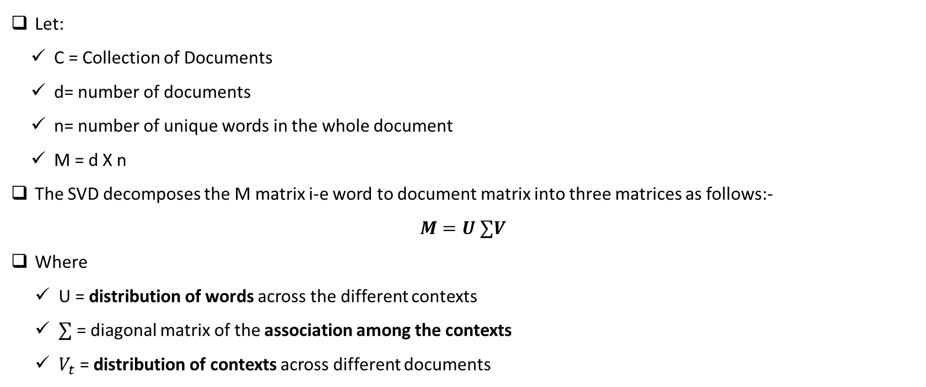
LATENT SEMANTIC ANALYSIS
Let:
C = Collection of Documents
d= number of documents
n= number of unique words in the whole document
M = d X n
The SVD decomposes the M matrix i-e word to document matrix into three matrices as follows:-
$$M=U ∑V$$
Where
U = distribution of words across the different contexts
$∑$ = diagonal matrix of the association among the contexts
$V_{t}$ = distribution of contexts across different documents

Slide 21
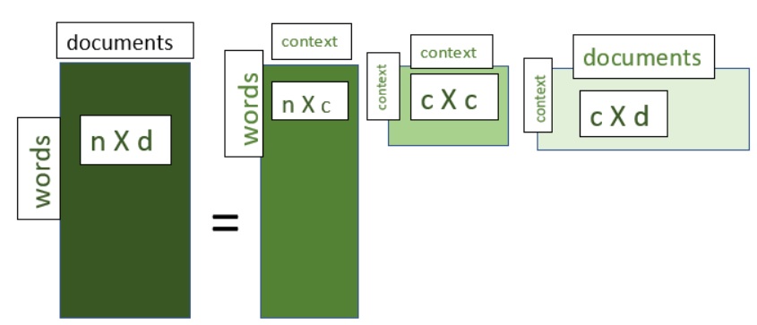
LATENT SEMANTIC ANALYSIS

Slide 22
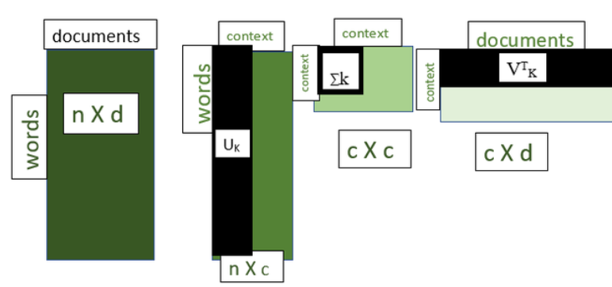
LATENT SEMANTIC ANALYSIS
A very significant feature of SVD is that it allows us to truncate few contexts which are not necessarily required by us.
The ∑ matrix provides us with the diagonal values which represent the significance of the context from highest to the lowest
By using these values we can reduce the dimensions and hence this can be used as a dimensionality reduction technique too
If we select the k the largest diagonal values in ∑ a matrix we obtain
M_{k} = U_{k}∑_{k}V^{T}_{K}

Slide 23
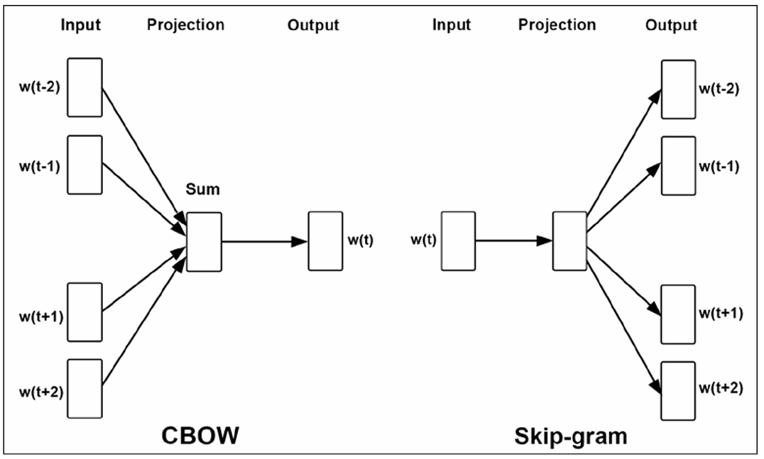
WORD2VEC
The models known as Word2Vec were first created in 2013 by a team of researchers at Google led by Tomas Mikolov [1, 2, 3]
The models are self-supervised, that is, they are supervised models that depend on the structure of natural language to provide labeled training data
The two architectures for Word2Vec are as follows:
Continuous Bag of Words (CBOW)
Skip-gram

Slide 24
WORD2VEC
In the skip-gram architecture, the model predicts the surrounding words given the context word.
According to the Word2Vec website, CBOW is faster, but skip-gram does a better job at predicting infrequent words.
We can simplify the skip-gram model objective of predicting a context word given a target word to basically predicting if a pair of words are contextually related.
Contextually related means that a pair of words within a context window are somehow related. That is, the input to the skip-gram model for the following first example would be the sparse vectors for the context words “The” and “Earth,” and the output would be the value 1
([The, Earth], 1) ([The, travels], 1)
We also need negative samples to train a model properly, so we generate additional negative samples by pairing each input word with some random word in the vocabulary. This process is called negative sampling and might result in the following additional inputs: ([Earth, zebra], 0)
Semantic analysis is a process that helps computers understand the meaning of words and phrases in context
Syntactic analysis, also known as parsing, is the process of analyzing a string of symbols using the rules of a formal grammar

Slide 25
WORD2VEC
A model trained with all of these inputs is called a Skip-Gram with Negative Sampling (SGNS) model
It is important to understand that we are not interested in the ability of these models to classify; rather, we are interested in the side effect of training – the learned weights.
These learned weights are what we call the embedding.
The Word2Vec model was trained in a self-supervised manner by Google on roughly 100 billion words from the Google News dataset and contains a vocabulary of 3 million words.
Google then released the pretrained model for anyone to download and use.
The pretrained Word2Vec model is available here (https://drive.google.com/file/d/0B7XkCwpI5KDYNlNUTTlSS21pQmM/edit).
The output vector dimensionality is 300. It is available as a BIN file and can be opened using Gensim by using gensim.

Slide 26
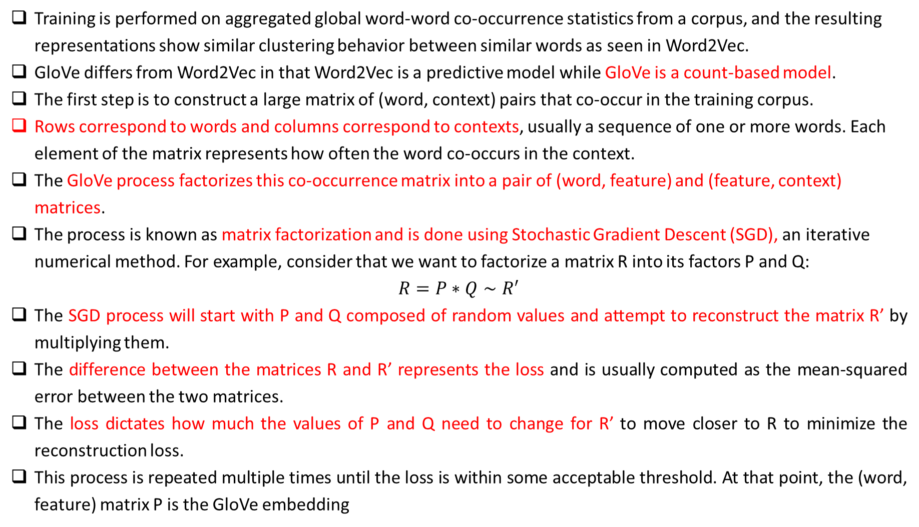
GLOBAL VECTOR FOR WORD EMBEDDING
Training is performed on aggregated global word-word co-occurrence statistics from a corpus, and the resulting representations show similar clustering behavior between similar words as seen in Word2Vec.
GloVe differs from Word2Vec in that Word2Vec is a predictive model while GloVe is a count-based model.
The first step is to construct a large matrix of (word, context) pairs that co-occur in the training corpus.
Rows correspond to words and columns correspond to contexts, usually a sequence of one or more words. Each element of the matrix represents how often the word co-occurs in the context.
The GloVe process factorizes this co-occurrence matrix into a pair of (word, feature) and (feature, context) matrices.
The process is known as matrix factorization and is done using Stochastic Gradient Descent (SGD), an iterative numerical method. For example, consider that we want to factorize a matrix R into its factors P and Q:
$$R=P∗Q∼R^{′}$$
The SGD process will start with P and Q composed of random values and attempt to reconstruct the matrix R’ by multiplying them.
The difference between the matrices R and R’ represents the loss and is usually computed as the mean-squared error between the two matrices.
The loss dictates how much the values of P and Q need to change for R’ to move closer to R to minimize the reconstruction loss.
This process is repeated multiple times until the loss is within some acceptable threshold. At that point, the (word, feature) matrix P is the GloVe embedding

Slide 27
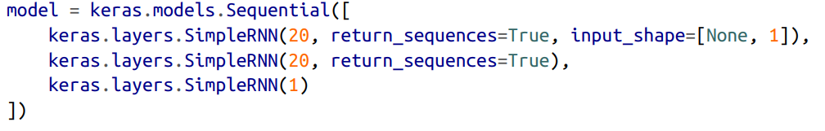
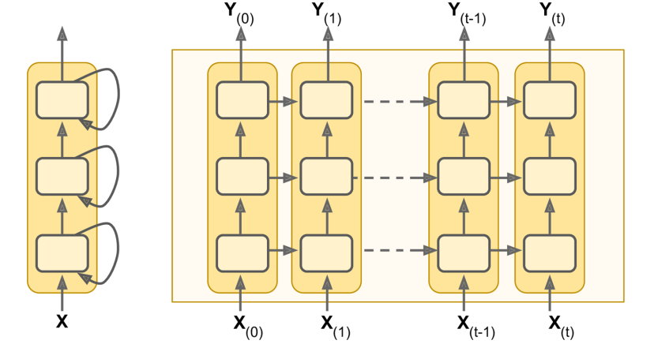
DEEP RNN, LSTM OR GRU
Make sure to set return_sequences=True for all recurrent layers (except the last one, if you only care about the last output). If you don’t, they will output a 2D array (containing only the output of the last time step) instead of a 3D array (containing outputs for all time steps), and the next recurrent layer will complain that you are not feeding it sequences in the expected 3D format.

Slide 28
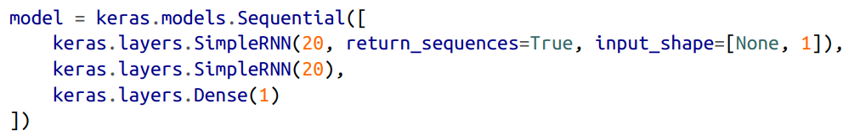
DEEP RNN, LSTM OR GRU
Note that the last layer is not ideal: it must have a single unit because we want to forecast a univariate time series, and this means we must have a single output value per time step. However, having a single unit means that the hidden state is just a single number. That’s really not much, and it’s probably not that useful; presumably, the RNN will mostly use the hidden states of the other recurrent layers to carry over all the information it needs from time step to time step, and it will not use the final layer’s hidden state very much. Moreover, since a SimpleRNN layer uses the tanh activation function by default, the predicted values must lie within the range –1 to 1. But what if you want to use another activation function? For both these reasons, it might be preferable to replace the output layer with a Dense layer: it would run slightly faster, the accuracy would be roughly the same, and it would allow us to choose any output activation function we want. If you make this change, also make sure to remove return_sequences=True from the second (now last) recurrent layer :

Slide 29
DEEP RNN, LSTM OR GRU
When to use return_sequences = True
Sentiment Analysis
Classification
Regression
When to use return_sequences = False
Sequence to Sequence Models like Machine Translation
Time Series Prediction at each step
Named Entity Recognition
Part of Speech Tagging

Slide 30
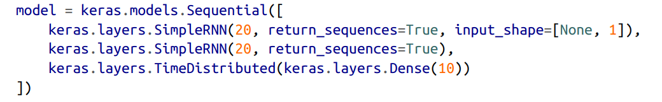
DEEP RNN, LSTM OR GRU
To turn the model into a sequence-to-sequence model, we must set return_sequences=True in all recurrent layers (even the last one), and we must apply the output Dense layer at every time step.
Keras offers a TimeDistributed layer for this very purpose: it wraps any layer (e.g., a Dense layer) and applies it at every time step of its input sequence. It does this efficiently, by reshaping the inputs so that each time step is treated as a separate instance (i.e., it reshapes the inputs from [batch size, time steps, input dimensions] to [batch size × time steps, input dimensions]; in this example, the number of input dimensions is 20 because the previous SimpleRNN layer has 20 units), then it runs the Dense layer, and finally it reshapes the outputs back to sequences (i.e., it reshapes the outputs from [batch size × time steps, output dimensions] to [batch size, time steps, output dimensions]; in this example the number of output dimensions is 10, since the Dense layer has 10 units).

Slide 31
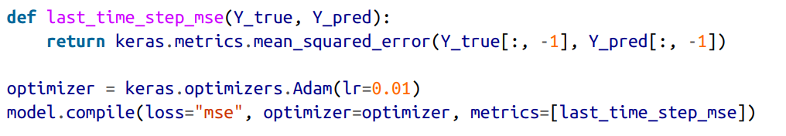
DEEP RNN, LSTM OR GRU
All outputs are needed during training, but only the output at the last time step is useful for predictions and for evaluation. So although we will rely on the MSE over all the outputs for training, we will use a custom metric for evaluation, to only compute the MSE over the output at the last time step

Slide 32
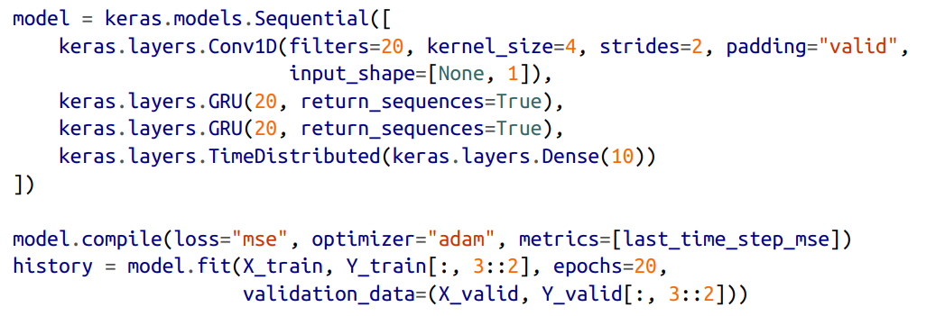
CONV2D COUPLED WITH GRU

Slide 33
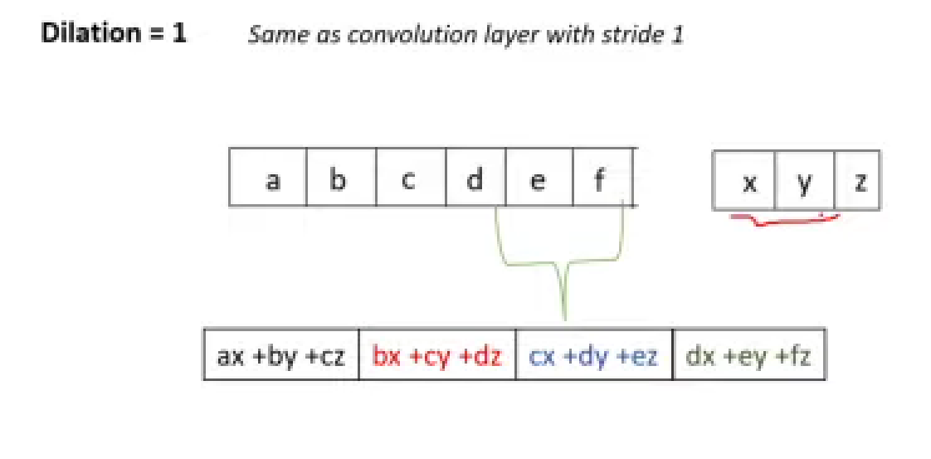
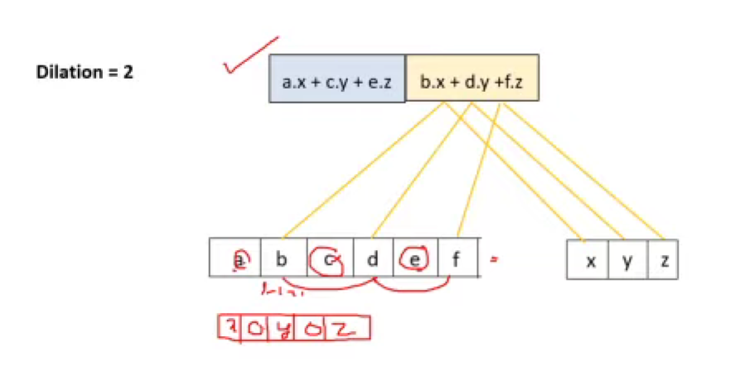
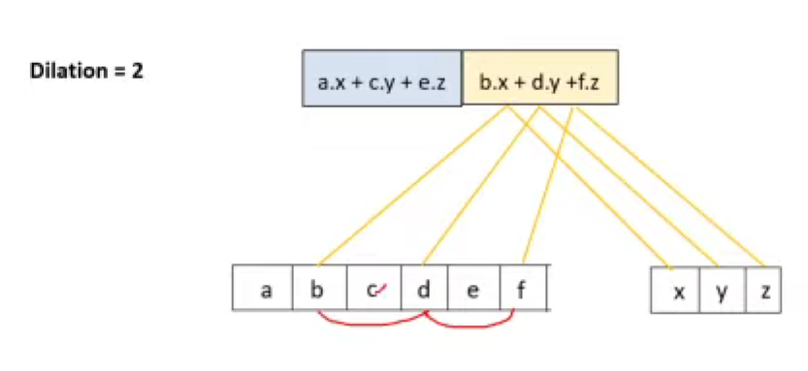
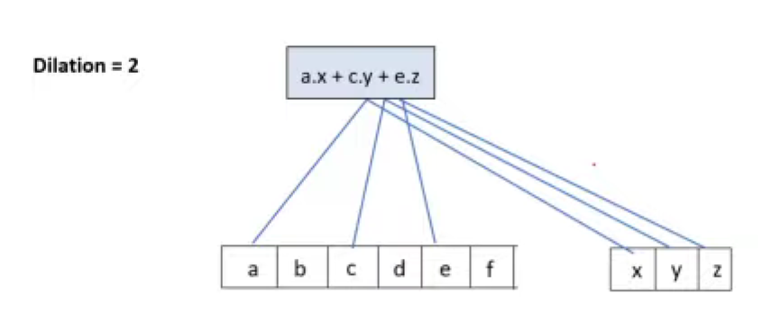
DILATED CONVOLUTION & WAVE NET
In a 2016 paper,13 Aaron van den Oord and other DeepMind researchers introduced an architecture called WaveNet
Dilated Convolution introduces gaps between the filter elements, allowing the network to have larger receptive fields without increasing the number of parameters. This makes them particularly useful in tasks requiring multiscale context and long range dependances, such as audio generation and image classification

Slide 34
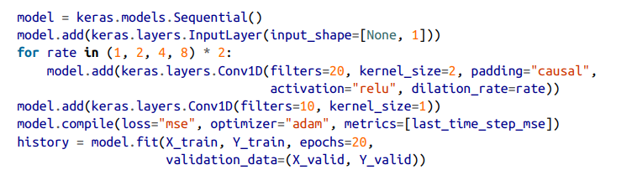
DILATED CONVOLUTION & WAVE NET
In the WaveNet paper, the authors actually stacked 10 convolutional layers with dilation rates of 1, 2, 4, 8, …, 256, 512, then they stacked another group of 10 identical layers (also with dilation rates 1, 2, 4, 8, …, 256, 512), then again another identical group of 10 layers.
They justified this architecture by pointing out that a single stack of 10 convolutional layers with these dilation rates will act like a super-efficient convolutional layer with a kernel of size 1,024 (except way faster, more powerful, and using significantly fewer parameters), which is why they stacked 3 such blocks. They also left-padded the input sequences with a number of zeros equal to the dilation rate before every layer, to preserve the same sequence length throughout the network

Slide 35
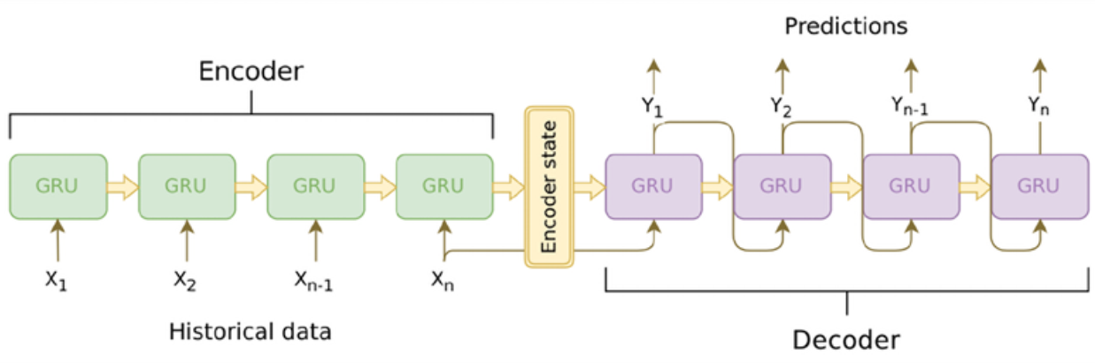
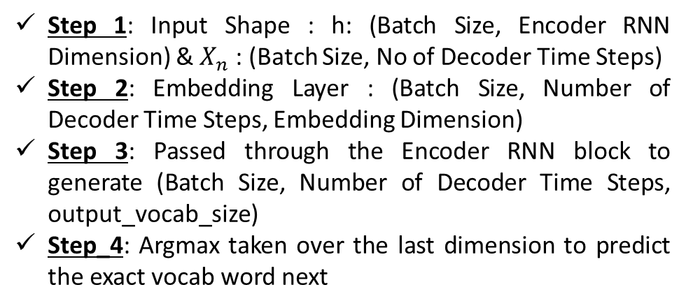
SEQ TO SEQ MODEL
Step 1: Input Shape : h: (Batch Size, Encoder RNN Dimension) & $X_{n}$ : (Batch Size, No of Decoder Time Steps)
Step 2: Embedding Layer : (Batch Size, Number of Decoder Time Steps, Embedding Dimension)
Step 3: Passed through the Encoder RNN block to generate (Batch Size, Number of Decoder Time Steps, output_vocab_size)
Step_4: Argmax taken over the last dimension to predict the exact vocab word next
Step 1: Input Shape : (Batch Size, Number of Encoder Time Steps)
Step 2: Embedding Layer : (Batch Size, Number of Encoder Time Steps, Embedding Dimension)
Step 3: Passed through the Encoder RNN block to generate (Batch Size, Encoder RNN Dimension)

Slide 36
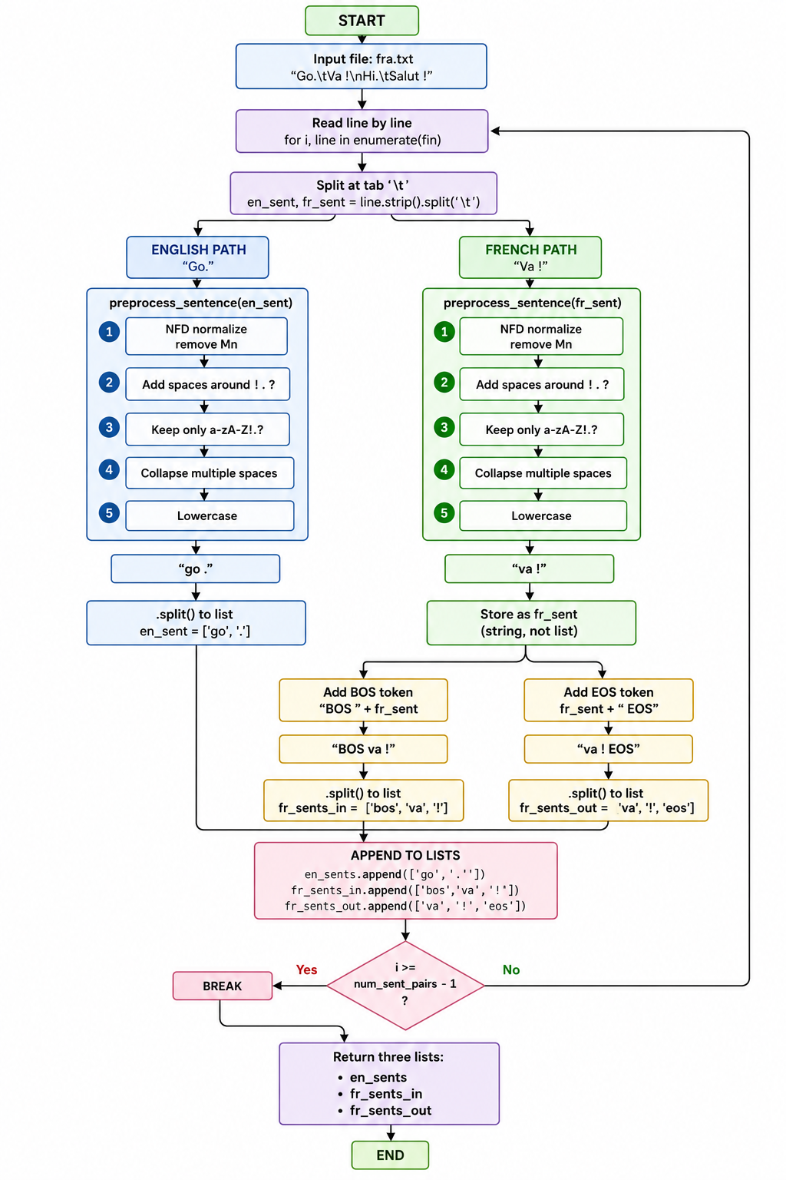
SEQ TO SEQ MODEL

Slide 37
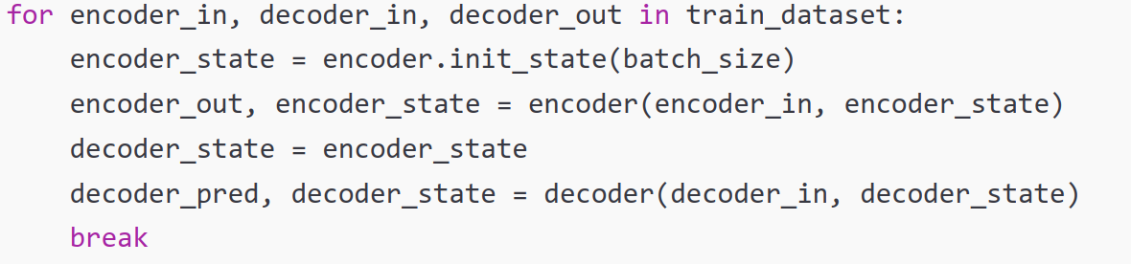
SEQ TO SEQ MODEL
data_en
data_fr_in
data_fr_out
Notes:
def download_and_read():
en_sents, fr_sents_in, fr_sents_out = [], [], [] local_file = os.path.join("datasets", "fra.txt")
with open(local_file, "r") as fin: for i, line in enumerate(fin):
en_sent, fr_sent = line.strip().split('\t')
en_sent = [w for w in preprocess_sentence(en_sent).split()] fr_sent = preprocess_sentence(fr_sent)
fr_sent_in = [w for w in ("BOS " + fr_sent).split()] fr_sent_out = [w for w in (fr_sent + " EOS").split()] en_sents.append(en_sent) fr_sents_in.append(fr_sent_in) fr_sents_out.append(fr_sent_out)
if i >= num_sent_pairs - 1: break
return en_sents, fr_sents_in, fr_sents_out

Slide 38
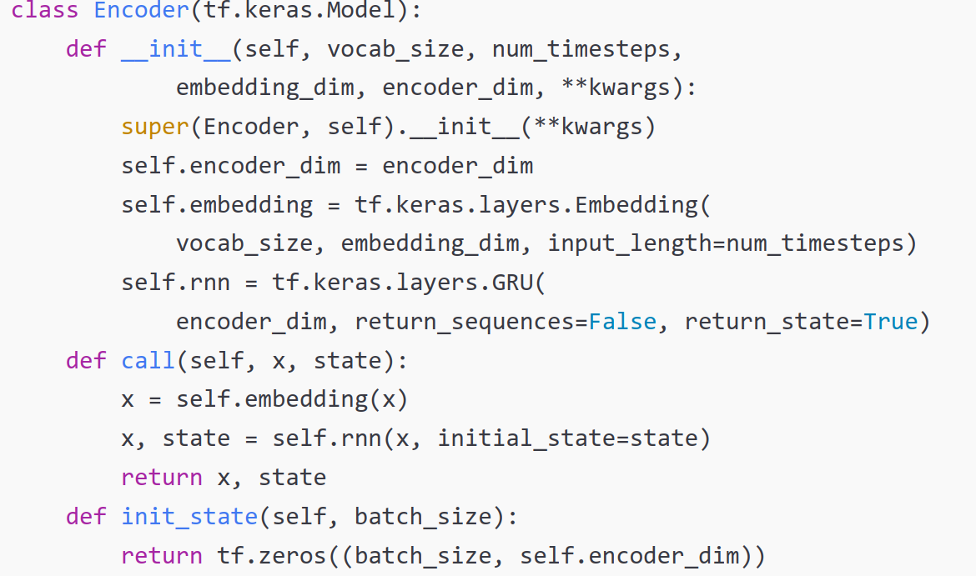
SEQ TO SEQ MODEL

Slide 39
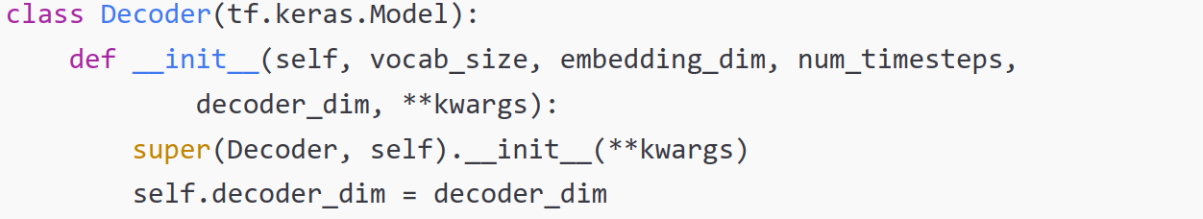
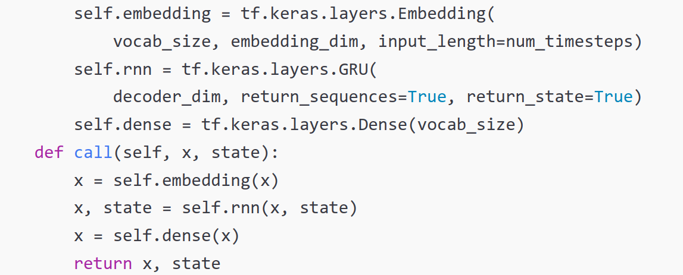
SEQ TO SEQ MODEL

Slide 40
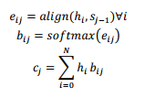
ATTENTION MECHANISM
We saw how the context or thought vector from the last time step of the encoder is fed into the decoder as the initial hidden state.
As the context flows through the time steps on the decoder, the signal gets combined with the decoder output and progressively gets weaker and weaker. The result is that the context does not have much effect on the later time steps in the decoder.
The result is that the context does not have much effect on the later time steps in the decoder
The attention mechanism provides access to all encoder hidden states at every time step on the decoder. The decoder learns which part of the encoder states to pay more attention to
The use of attention is not limited to seq2seq networks. For example, attention is a key component in the “Embed, Encode, Attend, Predict” formula for creating state-of-the-art deep learning models for NLP
Consider an encoder-decoder architecture where the input and output time steps are denoted by indices i and j respectively, and the hidden states on the encoder and decoder at these respective time steps are denoted by hi and sj. Inputs to the encoder are denoted by xi, and outputs from the decoder are denoted by yj.
Notes:
This preprocess_sentence function performs several text cleaning steps:
Remove diacritics (accents, tildes, etc.) unicodedata.normalize("NFD", sent) decomposes characters (e.g., "é" → "e" + "´"). Then unicodedata.category(c) != "Mn" keeps only characters that are not combining marks (like accents).
Add spaces around punctuation re.sub(r"([!.?])", r" \1", sent) inserts a space before !, ., ? (but keeps the punctuation).
Keep only letters, !, ., ? re.sub(r"[^a-zA-Z!.?]+", r" ", sent) replaces any character that is not a letter or ! . ? with a space.
Collapse multiple spaces re.sub(r"\s+", " ", sent) replaces any whitespace sequence with a single space.
Lowercase sent.lower()

Slide 41



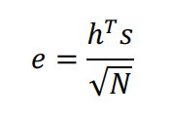
ATTENTION MECHANISM
Different attention mechanisms have been proposed including:-
Content Based Attention
Additive or Bahdanau attention
Multiplicative or Luong’s attention
Scaled Dotproduct Attention
Notes:
This preprocess_sentence function performs several text cleaning steps:
Remove diacritics (accents, tildes, etc.) unicodedata.normalize("NFD", sent) decomposes characters (e.g., "é" → "e" + "´"). Then unicodedata.category(c) != "Mn" keeps only characters that are not combining marks (like accents).
Add spaces around punctuation re.sub(r"([!.?])", r" \1", sent) inserts a space before !, ., ? (but keeps the punctuation).
Keep only letters, !, ., ? re.sub(r"[^a-zA-Z!.?]+", r" ", sent) replaces any character that is not a letter or ! . ? with a space.
Collapse multiple spaces re.sub(r"\s+", " ", sent) replaces any whitespace sequence with a single space.
Lowercase sent.lower()

Slide 42
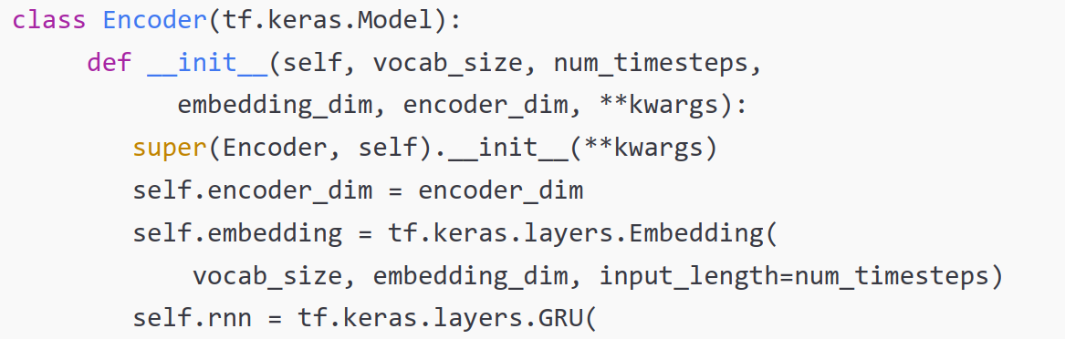
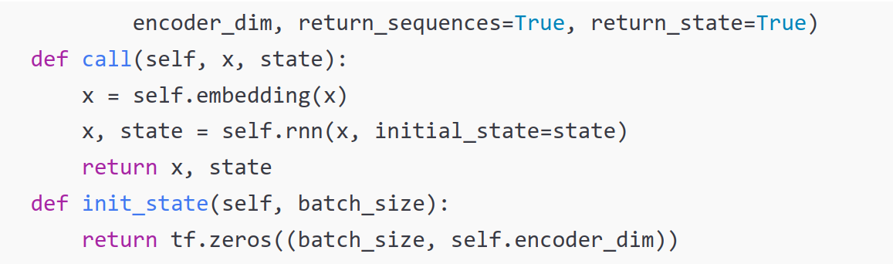
ATTENTION MECHANISM
Notes:
This preprocess_sentence function performs several text cleaning steps:
Remove diacritics (accents, tildes, etc.) unicodedata.normalize("NFD", sent) decomposes characters (e.g., "é" → "e" + "´"). Then unicodedata.category(c) != "Mn" keeps only characters that are not combining marks (like accents).
Add spaces around punctuation re.sub(r"([!.?])", r" \1", sent) inserts a space before !, ., ? (but keeps the punctuation).
Keep only letters, !, ., ? re.sub(r"[^a-zA-Z!.?]+", r" ", sent) replaces any character that is not a letter or ! . ? with a space.
Collapse multiple spaces re.sub(r"\s+", " ", sent) replaces any whitespace sequence with a single space.
Lowercase sent.lower()

Slide 43
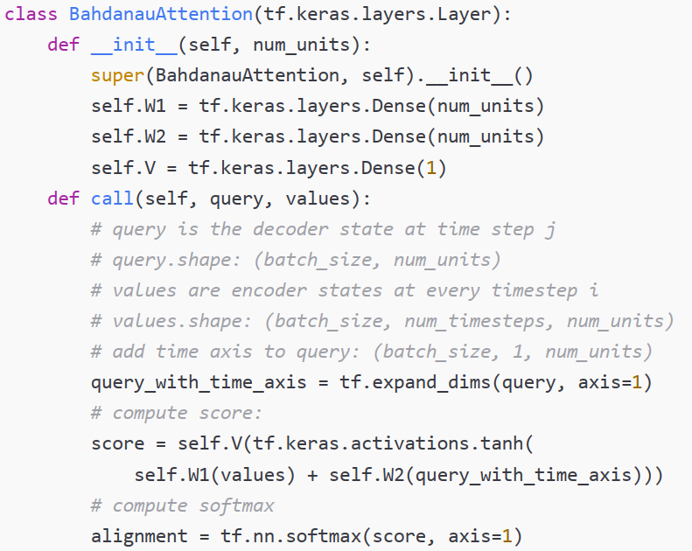
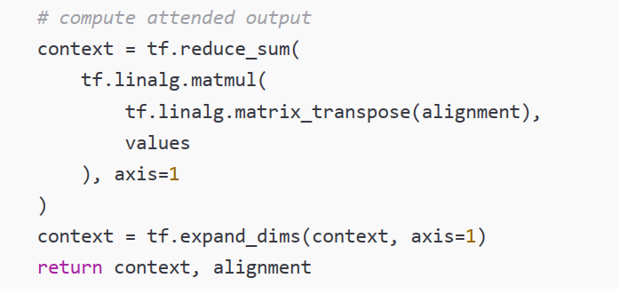

ATTENTION MECHANISM
Notes:
This preprocess_sentence function performs several text cleaning steps:
Remove diacritics (accents, tildes, etc.) unicodedata.normalize("NFD", sent) decomposes characters (e.g., "é" → "e" + "´"). Then unicodedata.category(c) != "Mn" keeps only characters that are not combining marks (like accents).
Add spaces around punctuation re.sub(r"([!.?])", r" \1", sent) inserts a space before !, ., ? (but keeps the punctuation).
Keep only letters, !, ., ? re.sub(r"[^a-zA-Z!.?]+", r" ", sent) replaces any character that is not a letter or ! . ? with a space.
Collapse multiple spaces re.sub(r"\s+", " ", sent) replaces any whitespace sequence with a single space.
Lowercase sent.lower()

